Slide 1

Introducing PyCaret 1.0x
Jul 4, 2020

Slide 2





About me
Data Analytics Leader by day and passionate Data Scientist by night
Active open-source contributor
Member of CPA, CMA, Canada and ACMA, UK CGMA
Lived and worked in Asia, Middle East, East Africa, North America
Currently based in Toronto, Canada
https://www.linkedin.com/in/profile-moez/
https://medium.com/@moez_62905/
https://twitter.com/moezpycaretorg1
moez@pycaret.org

Slide 3
Important Links
Official : https://www.pycaret.org
PyCaret GitHub : https://www.github.com/pycaret/pycaret
LinkedIn : https://www.linkedin.com/company/pycaret
YouTube : https://www.youtube.com/channel/UCxA1YTYJ9BEeo50lxyI_B3g
Medium : https://medium.com/@moez_62905/
Today’s Presentation and Demo : https://www.github.com/pycaret/tfmeetup
Follow hashtag #pycaret on LinkedIn and Twitter

Slide 4
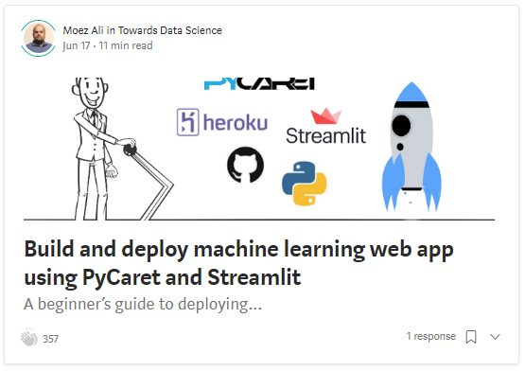
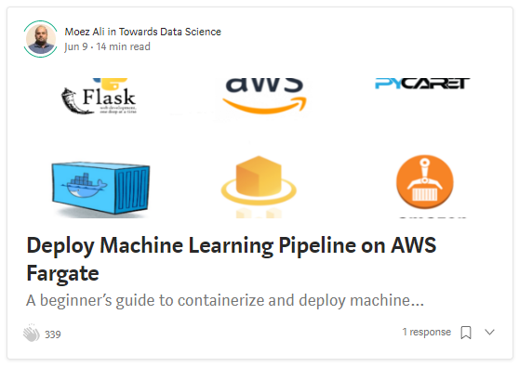
Resources
https://towardsdatascience.com/build-and-deploy-machine-learning-web-app-using-pycaret-and-streamlit-28883a569104
https://towardsdatascience.com/deploy-machine-learning-pipeline-on-aws-fargate-eb6e1c50507

Slide 5
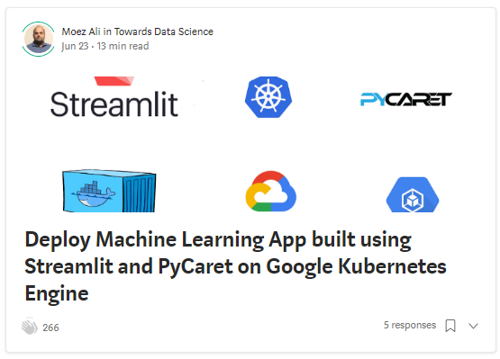
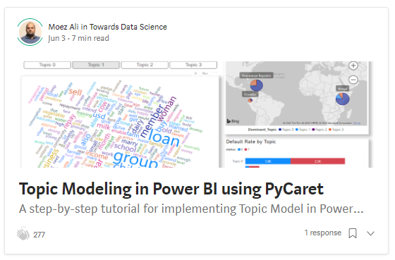
Resources (cont.)
https://towardsdatascience.com/deploy-machine-learning-app-built-using-streamlit-and-pycaret-on-google-kubernetes-engine-fd7e393d99cb
https://towardsdatascience.com/topic-modeling-in-power-bi-using-pycaret-54422b4e36d6

Slide 6
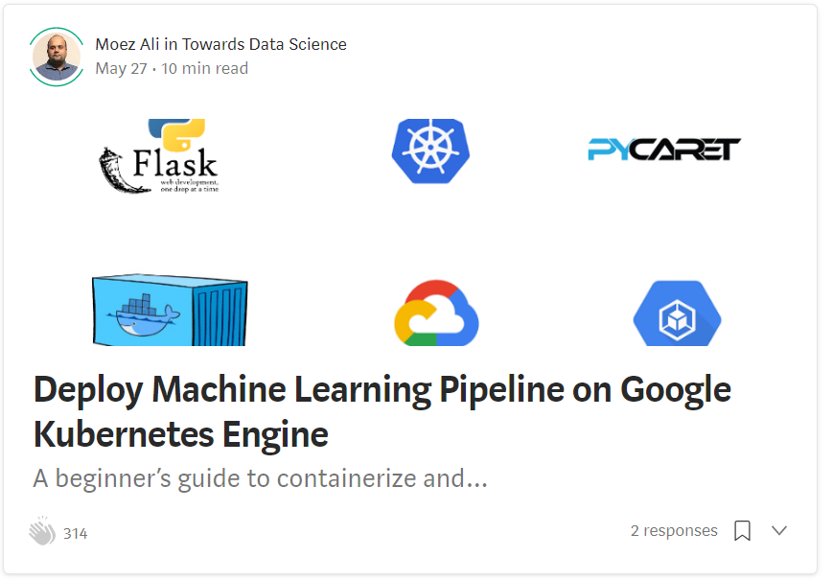
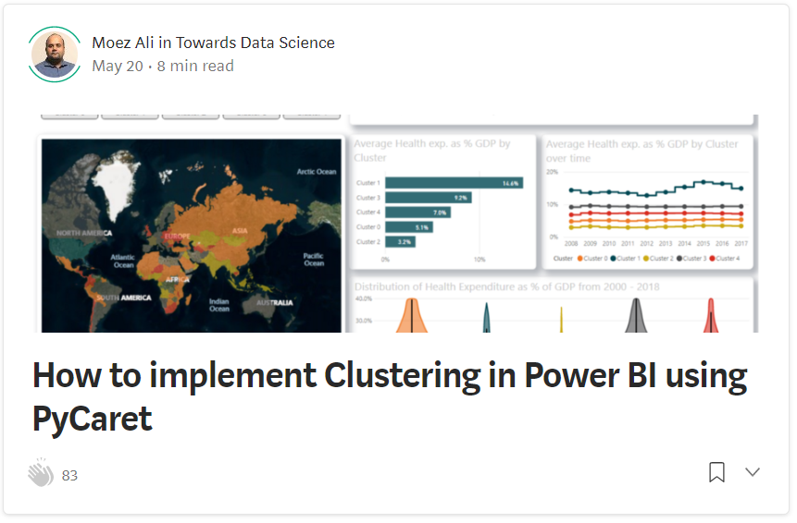
Resources (cont.)
https://towardsdatascience.com/deploy-machine-learning-model-on-google-kubernetes-engine-94daac85108b
https://towardsdatascience.com/how-to-implement-clustering-in-power-bi-using-pycaret-4b5e34b1405b

Slide 7
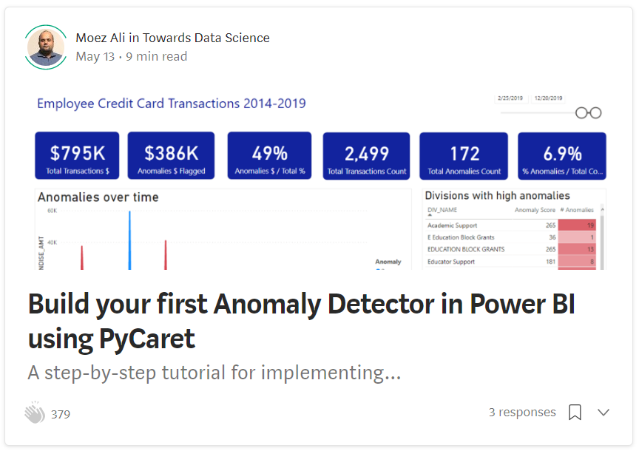
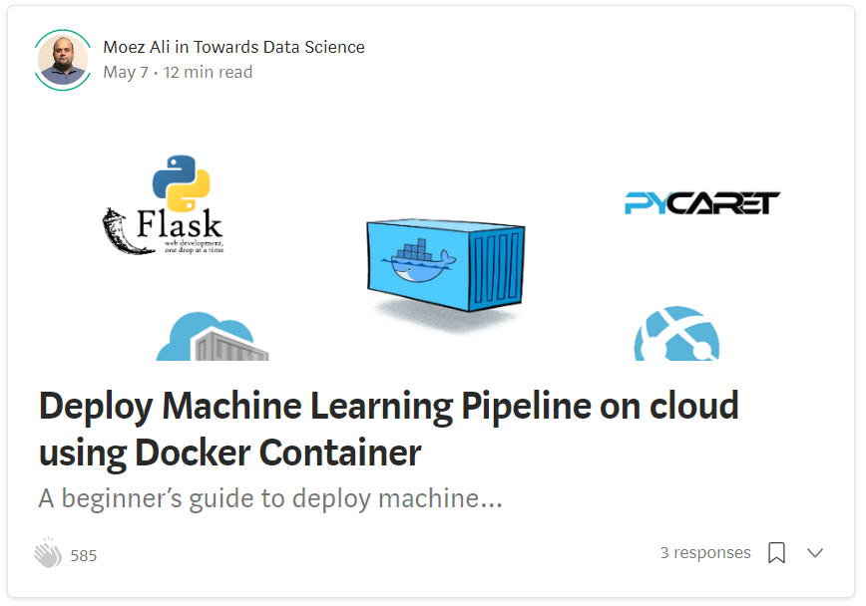
Resources (cont.)
https://towardsdatascience.com/build-your-first-anomaly-detector-in-power-bi-using-pycaret-2b41b363244e
https://towardsdatascience.com/deploy-machine-learning-pipeline-on-cloud-using-docker-container-bec64458dc01

Slide 8
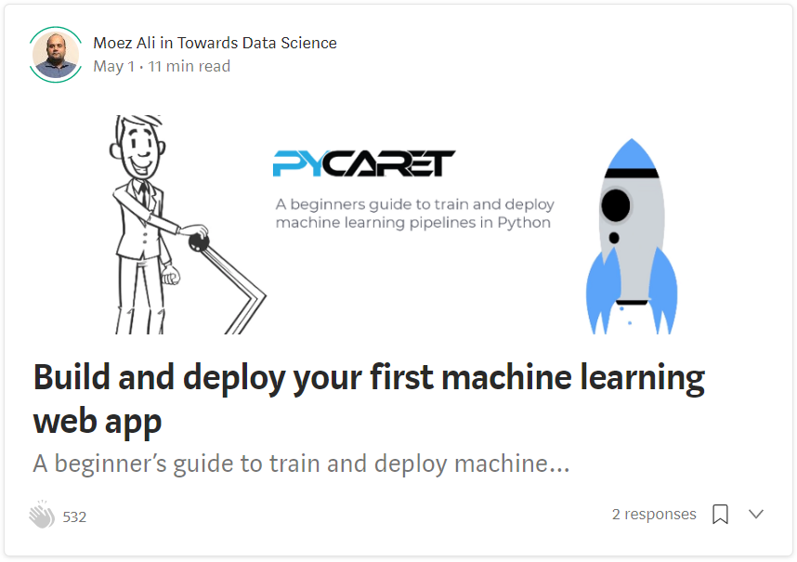
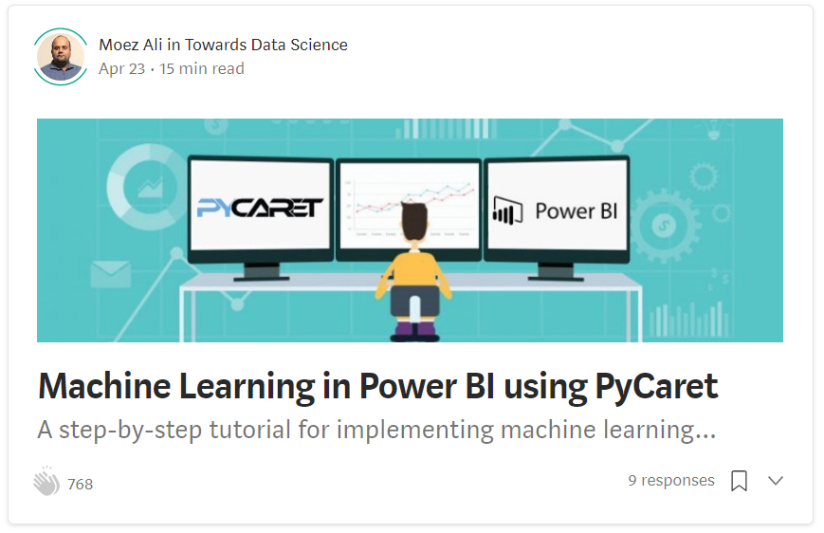
Resources (cont.)
https://towardsdatascience.com/build-and-deploy-your-first-machine-learning-web-app-e020db344a99
https://towardsdatascience.com/machine-learning-in-power-bi-using-pycaret-34307f09394a

Slide 9
Resources (cont.) – Official Video Tutorials
Binary Classification Video Tutorial
https://www.youtube.com/watch?v=2xAgLKUN6Xs
Clustering in PyCaret Video Tutorial
https://www.youtube.com/watch?v=2oxLDir7foQ
Anomaly Detection in PyCaret Video Tutorial
https://www.youtube.com/watch?v=q0dxYDq1A40&t=2s
Topic Modeling in PyCaret Video Tutorial
https://www.youtube.com/watch?v=G6ShuoM3T1M
Association Rule Mining in PyCaret Video Tutorial
https://www.youtube.com/watch?v=XYAGwts5qGw

Slide 10
Resources (cont.)
Machine Learning in SQL by Umar Farooque
https://towardsdatascience.com/machine-learning-in-sql-using-pycaret-87aff377d90c
PyCaret’s integration with Tableau by Andrew Cowan-Nagora
https://towardsdatascience.com/machine-learning-in-tableau-with-pycaret-166ffac9b22e
NLP Classification using PyCaret by Prateek Baghel
https://towardsdatascience.com/predicting-crashes-in-gold-prices-using-machine-learning-5769f548496
Predict Gold Price Returns using PyCaret by Riazuddin Mohammad
https://towardsdatascience.com/machine-learning-to-predict-gold-price-returns-4bdb0506b132
Predict Crashes in Gold Price using PyCaret by Riazuddin Mohammad
https://towardsdatascience.com/predicting-crashes-in-gold-prices-using-machine-learning-5769f548496

Slide 11
Resources (cont.)
Binary Classification Notebook by Murali Tedla
https://colab.research.google.com/drive/1W6ZYw5oAN7V85utFkXkCQq3iBWjqP1WB
Wine Quality Prediction by Abhinav Arora
https://colab.research.google.com/drive/1uFNmhgM9ghVrtqN3MXaofxDlLePb3yIi#scrollTo=sYsHyY8uH6tb
Build your machine learning models by Lakshay Arora
https://www.analyticsvidhya.com/blog/2020/05/pycaret-machine-learning-model-seconds/
PyCaret’s Integration with Power BI (1 Hour Video Tutorial)
https://www.youtube.com/watch?v=ZeQVkEWo2x0
Anomaly Detection using PyCaret by Krish Naik (Video Tutorial)
https://www.youtube.com/watch?v=ZeQVkEWo2x0

Slide 12
Let’s get started
If you plan to follow along the demo part. You can clone the following GitHub repository:
https://www.github.com/pycaret/pycaret-demo-tfmeetup
Alternatively, you can run the notebooks on Google Colab. Follow the link below:
https://pycaret.org/demo/
To install pycaret on your local machine type “pip install pycaret” in Jupyter Notebook or Anaconda Prompt. Installation will take 5-10 minutes.

Slide 13

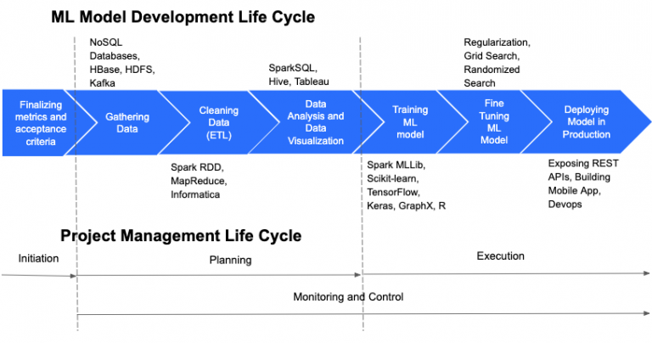
https://cloudxlab.com/blog/things-to-consider-while-managing-machine-learning-projects/machine-learning-and-project-management-life-cycle-2/

Slide 14
Granular ML Life Cycle of a supervised experiment
Business Problem
Define ML Objective
Collect Data
Analyze
Train Test Split
Handle Datatypes
Impute Missing Values
… zillion other things
Feature Selection
Feature Interaction
Feature Engineering
Transformations
Scaling
Encodings
REPEAT
Model Training
Cross Validation
Track Performance
Hyperparameter tuning
Track Performance
Ensemble Model
Track Performance
Deploy Model
… zillion other things
Analyze Plots
Track Performance
Stack Models
Track Performance
Blend Models

Slide 15
What’s the challenge?
Machine Learning is an iterative process.
It’s about asking the right questions and in order to get to right questions it’s important to remain focused.
Creating a seamless pipeline is hard. Managing it is harder.
Current tools are not business-friendly. Domain expertise play big role in ML experiments, however they are not empowered.

Slide 16



Here comes PyCaret.
PyCaret is an open source, low-code machine learning library in Python that aims to reduce the cycle time from hypothesis to insights. PyCaret can be used for rapidly developing and deploying machine learning pipeline.
EASY TO USE
PRODUCTIVITY TOOL
BUSINESS READY

Slide 17
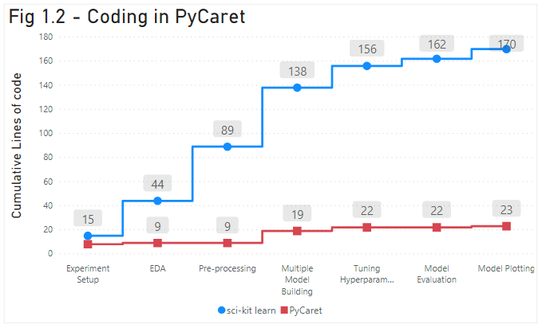
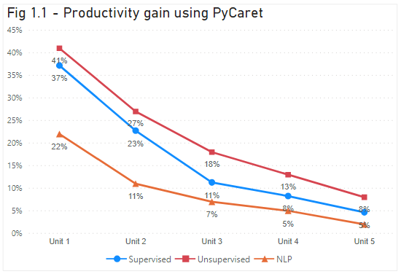
Difference of using PyCaret

Slide 18
Facts
Started in summer of 2019
Written in Python. Future versions may include wrappers in other langs.
Project took approximately 1 year to complete.
Self-funded so far.
Supported by team of brilliant people. To contribute please visit https://www.pycaret.org/contribute

Slide 19
Who should use PyCaret?
Data scientists who wants to increase their productivity.
Consultants / Data Science teams for rapid prototyping and POC projects.
Students no prior background in computer science.
Data science professionals seeking to combine simplicity of R language with power of Python.
Data Science Professional's who compete on platforms like Kaggle.

Slide 20
PyCaret 2.0x is coming!
Command line support.
MLflow UI integration for tracking will be released in beta.
Modular AutoML - beta release.
Native support for Databricks.
Major scalability improvements + bug fix.

Slide 21


Demo
Clone repository from https://github.com/pycaret/pycaret-demo-tfmeetup
Install PyCaret by running "pip install pycaret" in Notebook or in Anaconda prompt
If you are using MAC OS, you might have to install LightGBM separately. Follow instructions on this link: https://www.pycaret.org/install
Links to demo notebook at https://www.pycaret.org/demo
You can also execute the notebook in playground mode by installing pycaret on colab by using "!pip install pycaret".
You must have a google account to use Google colab.

Slide 22
Thank you
Questions?

